Slide 1

Exam AZ-700: Designing and Implementing Azure Networking Solutions Crash Course
Tim Warner

Slide 2


Tim Warner
Based in Nashville, TN, US
Central time zone
Twitter: @TechTrainerTim
Web: TechTrainerTim.com

Slide 3
Day 1 of 2 Agenda
Introduction
Hybrid Networking
Core Networking Infrastructure
Routing, Start

Slide 4
Day 2 of 2 Agenda
Routing, Finish
Secure and Monitor Networks
Private Access to Networks

Slide 5
Course Materials
timw.info/az700

Slide 6
A Different Kind of Training
This is an Associate (not Fundamentals) certification, so we will move quickly and assume intermediate-level Azure skills
CompTIA Network+ covers Ethernet and TCP/IP fundamentals
2 hours / 15 minute break / 1 hour 45 min
Plan on reviewing the playback recording

Slide 7
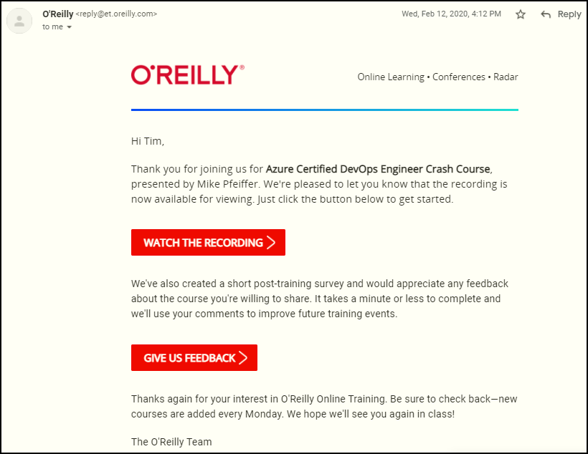
Session Recordings

Slide 8

Session Recordings

Slide 9

Session Recordings

Slide 10


Session Recordings

Slide 11
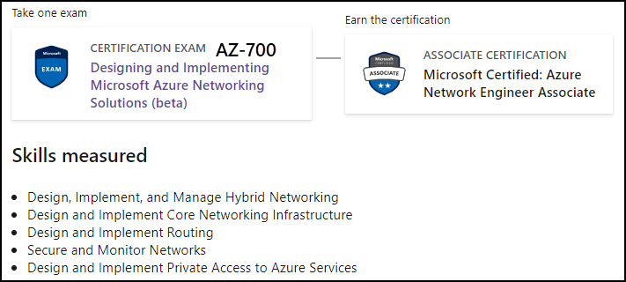
Azure Network Engineer Associate

Slide 12

Tim's Certification Study Model
Content knowledge
Test-taking skills
Practical application

Slide 13
Thank you!
Course materials: timw.info/az700
Twitter: @TechTrainerTim
Work: timw.info/ps
Web: TechTrainerTim.com

Slide 14

VM Networking

Slide 15

Site-to-Site VPN

Slide 16
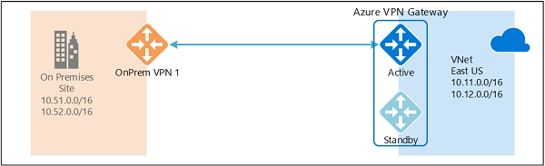
Active/Active VPN Topologies

Slide 17
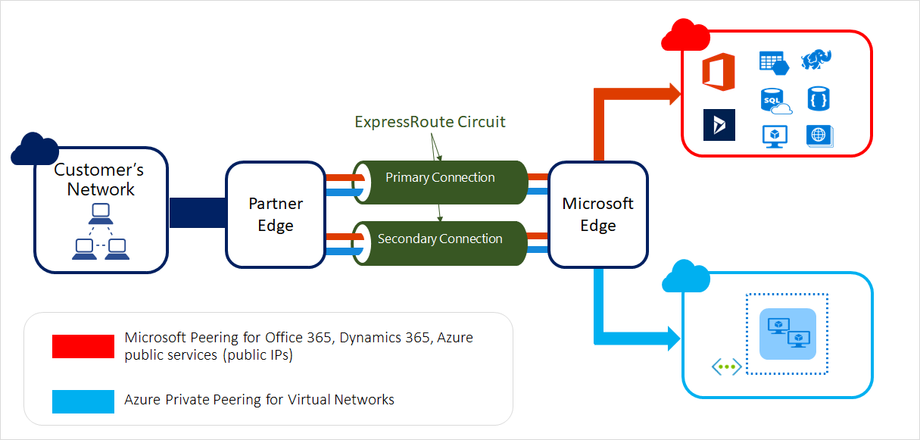
ExpressRoute Peering Types

Slide 18
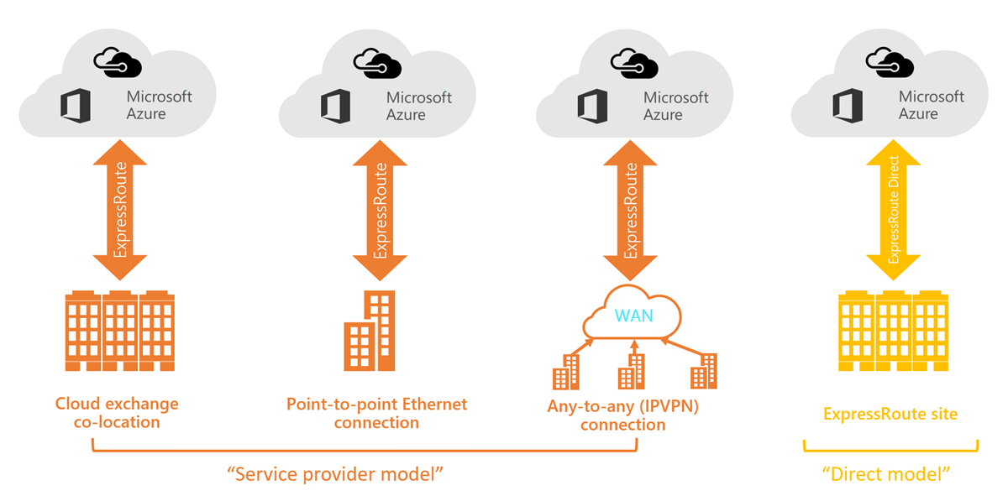
ExpressRoute Service Models

Slide 19
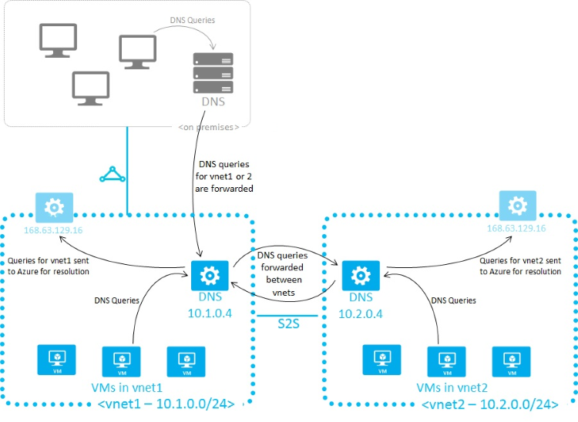
Azure Name Resolution

Slide 20
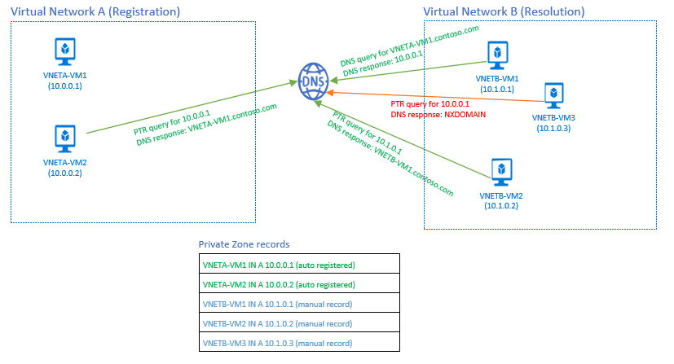
Azure DNS Private Zones

Slide 21
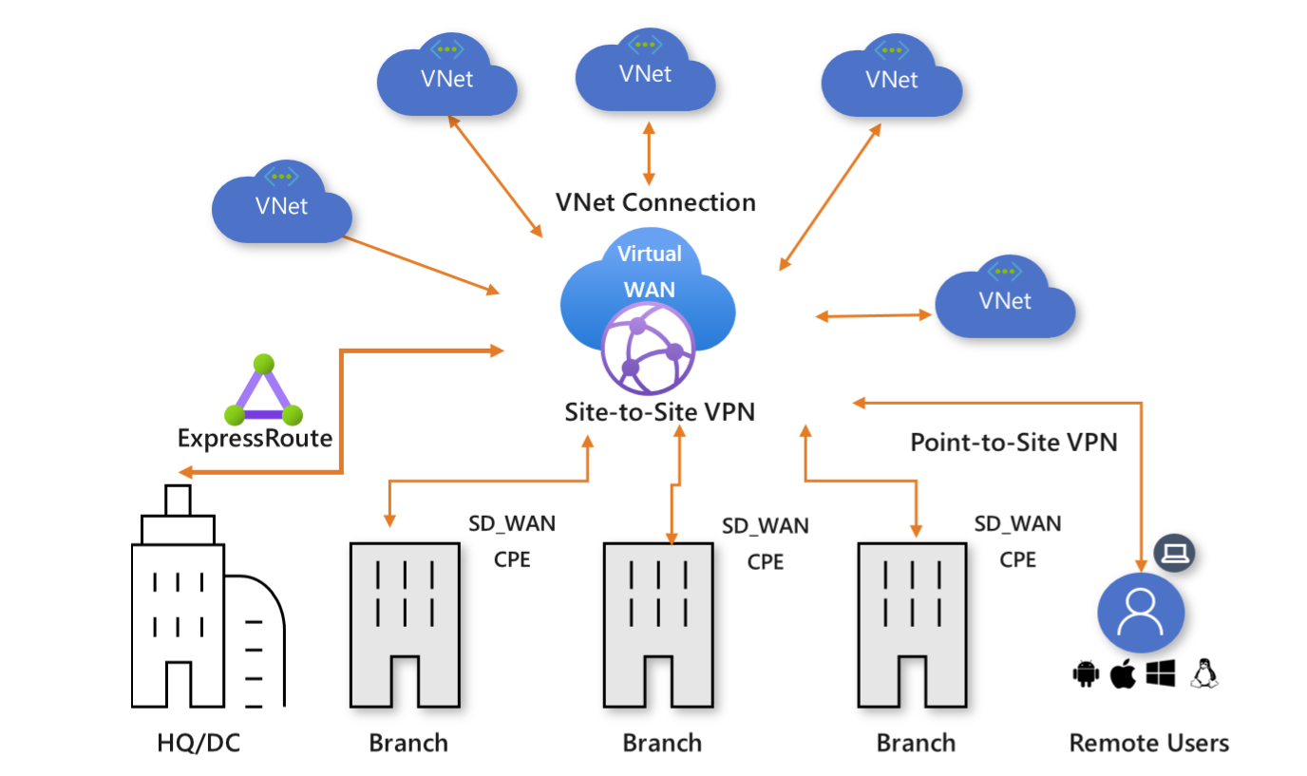
Virtual WAN

Slide 22
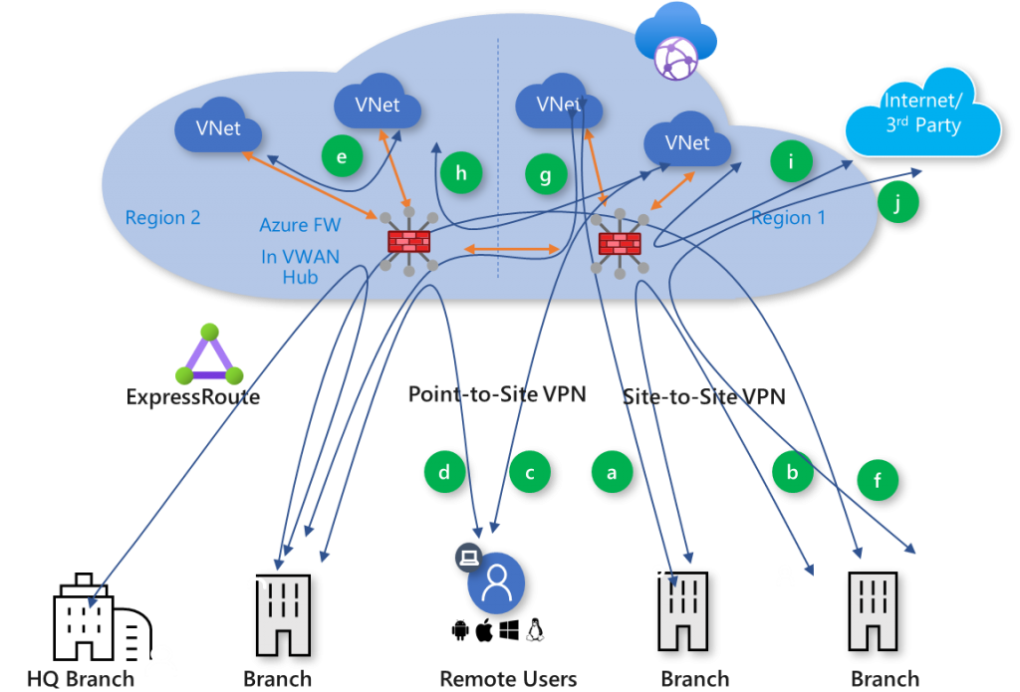
Secured Virtual Hub

Slide 23


Load Balancing

Slide 24

VNet Peering

Slide 25

Network Virtual Appliance

Slide 26

Azure Load Balancer

Slide 27

Application Gateway

Slide 28
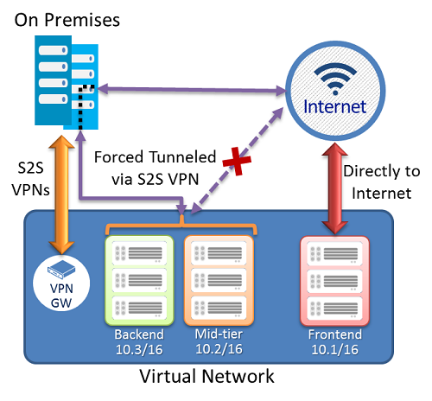
Forced Tunneling - S2S VPN

Slide 29
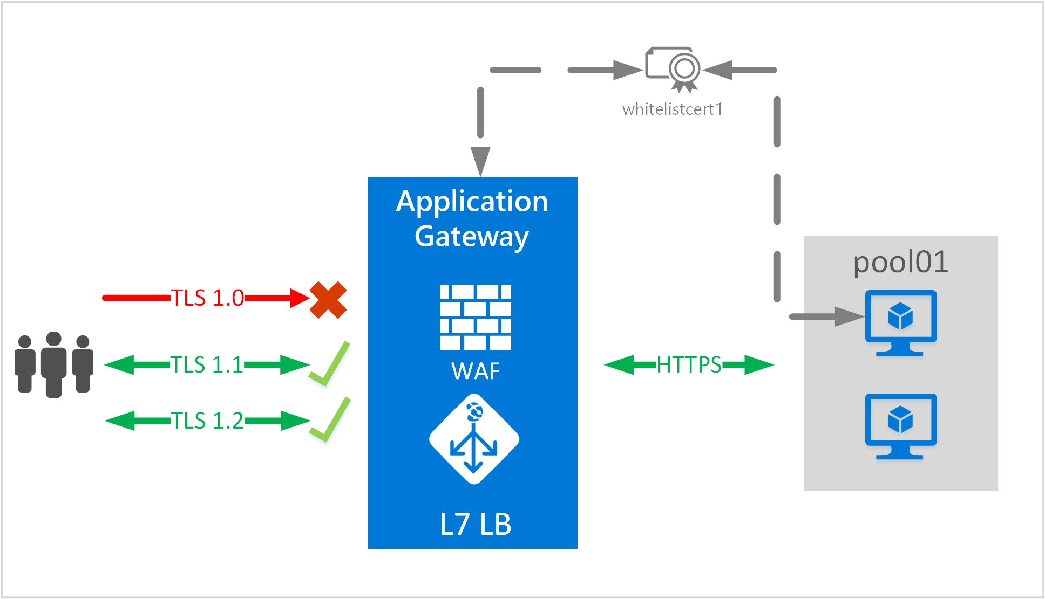

App Gateway E2E TLS

Slide 30
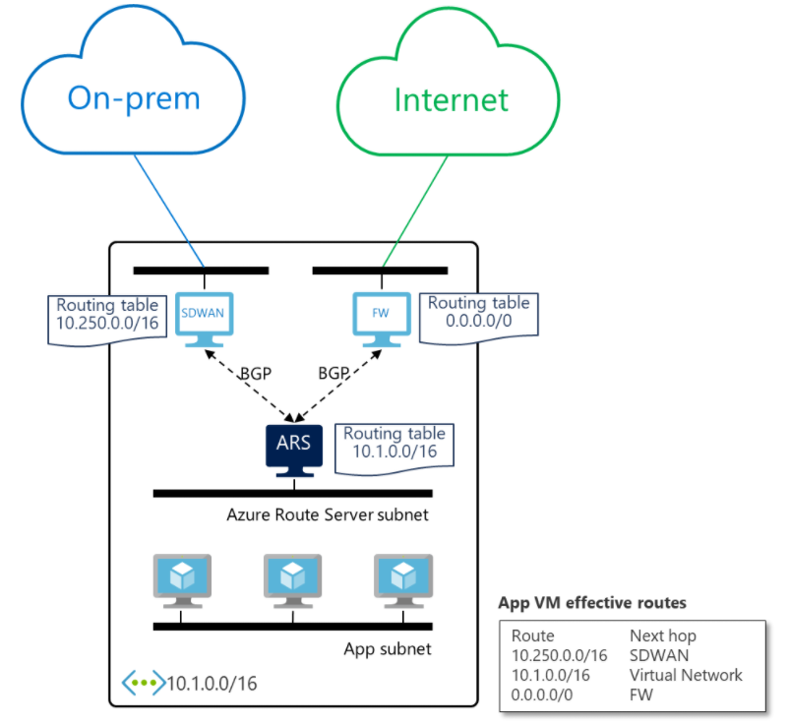
Azure Route Server

Slide 31
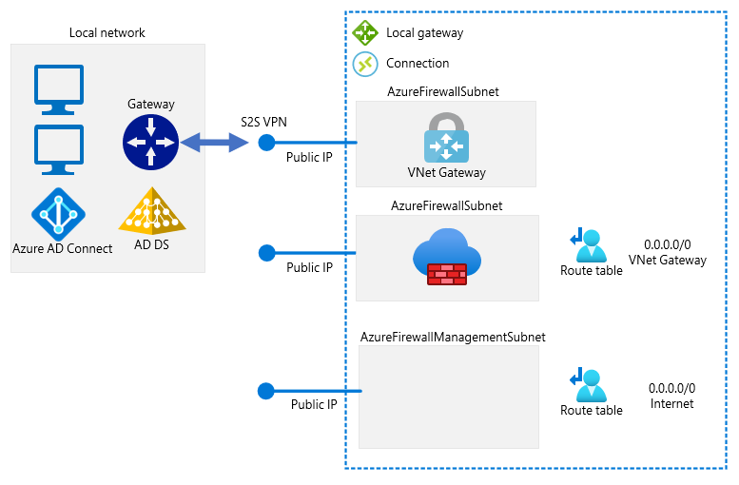
Forced Tunneling - Azure Firewall

Slide 32
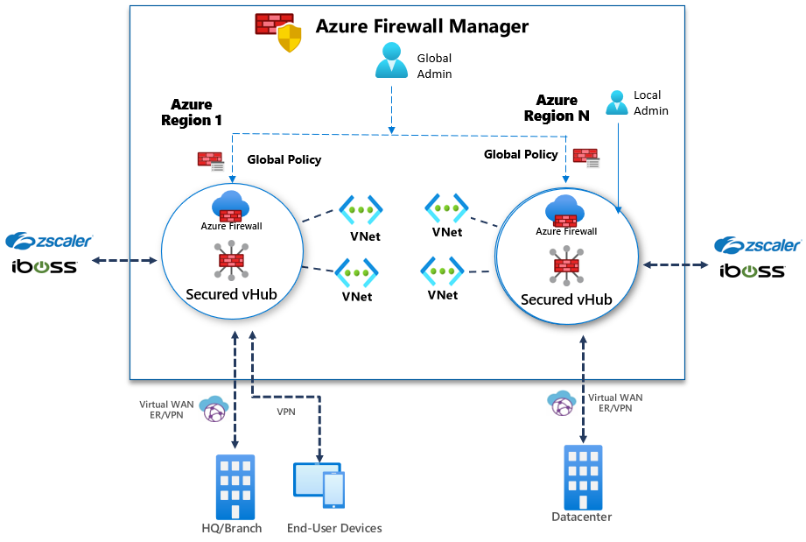
Azure Firewall Manager

Slide 33

Traffic Manager

Slide 34

Front Door Service

Slide 35
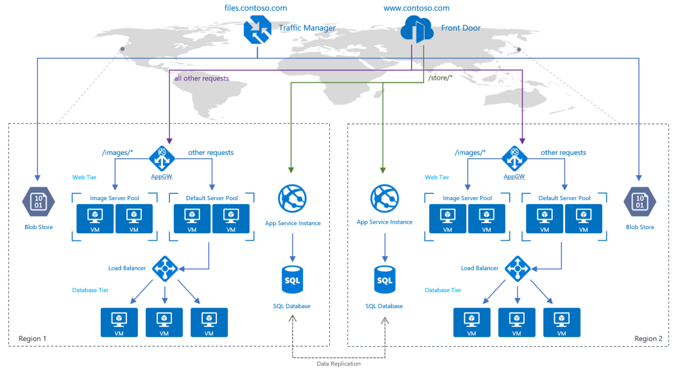
Traffic Manager vs Front Door

Slide 36
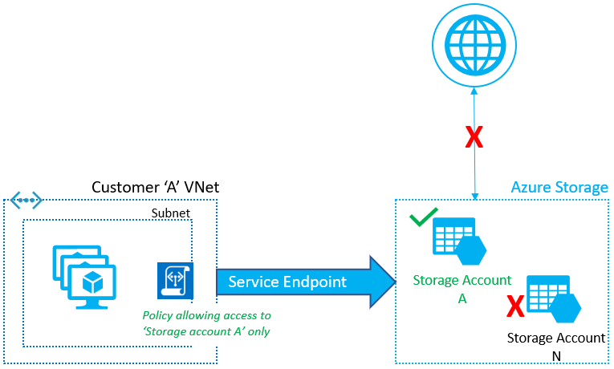
Service Endpoints

Slide 37
Private Endpoints

Slide 38
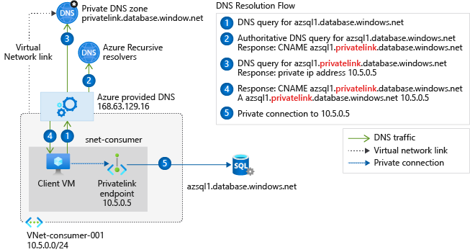
Private Endpoint DNS Config
Access from Azure

Slide 39
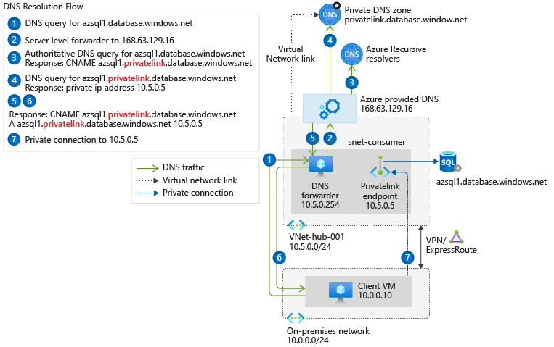
Private Endpoint DNS Config
Access from on-premises
Access from on-premises

Slide 40

Azure Monitor

Slide 41
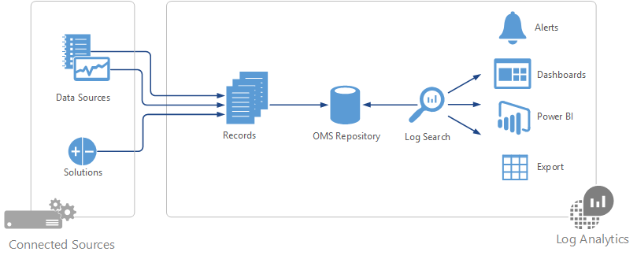

Log Analytics

Slide 42
Exam AZ-700 Item Types

Slide 43

Multiple Choice

Slide 44

Multiple Choice

Slide 45
Repeated Scenario
You need to move an Azure VM to another hardware host.
Solution: You redeploy the VM.
Does this solution meet the goal?
Yes
No

Slide 46
Repeated Scenario
You need to move an Azure VM to another hardware host.
Solution: You create a proximity placement group.
Does this solution meet the goal?
Yes
No

Slide 47

Select and Place

Slide 48

Build List and Reorder

Slide 49
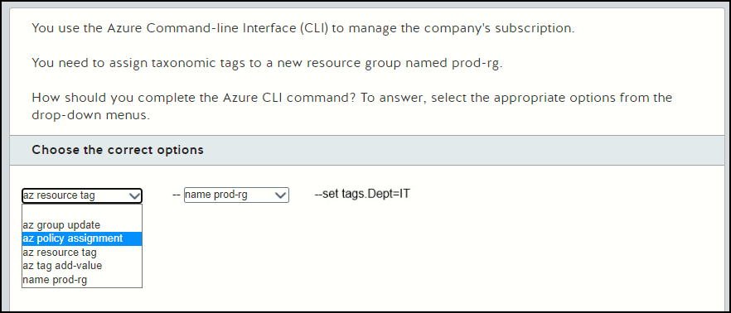
Active Screen

Slide 50

Case Study

Slide 51






Performance-Based Lab

Slide 52
Microsoft Online Testing Process
timw.info/online

Slide 53

Microsoft Online Testing Process

Slide 54

Microsoft Online Testing Process

Slide 55

Microsoft Online Testing Process

Slide 56

Microsoft Online Testing Process

Slide 57

Microsoft Online Testing Process

Slide 58

Microsoft Online Testing Process

Slide 59

Microsoft Online Testing Process

